Slide 1
Mini Project-Insurance Policy Endorsement(ePES)

Slide 2

Team Members
Abhinav Acharya-161258
Nikhil Rupainwar(POC)-161770
Prachi Nahata-161568
Rashmi Wani-161616
Sai Priya-161265
Tushar Pathak- 161697

Slide 3
Project Details
Policy Endorsement System is basically a management system regarding Policy Endorsement. A life insurance endorsement is a document that is used in order to make some type of change to the original life insurance policy. This is typically a piece of paper that is attached to the original document. You will be able to read the document and see exactly what has been changed from the original policy that was used by the insurance company.
It is intended to perform the following tasks:
Customer and Admin both can login into the application.
Customer can view his basic personal details and will be able to update those details by submitting documents regarding to the change.
After submitting the documents for the updation process, request will be sent to the Admin and he will decide whether that document is valid or not and then he/she will approve or reject that request.
Customer can search for a specific policy by his/her Name or ID, Date of Birth and the Policy Number.
The work of Admin in this application is to approve or reject the request raised by the customer. And the Admin can also view all the details of all of the customers that are registered in the application.

Slide 4
Abstract of the Project
An Insurance company wants to set up Online policy endorsement facility for their Customers. They sell Life and Non Life products insurance to their customers.
This Online Policy Endorsement System should provide the following features to the customers:
Search Policy
View Policy details
Update Policy details (Endorsement)
Upload supporting documents
View Endorsement status

Slide 5
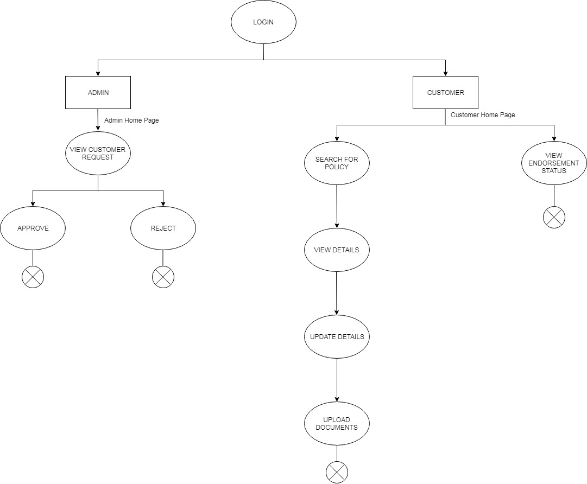
Diagram Depicting Entire Project

Slide 6
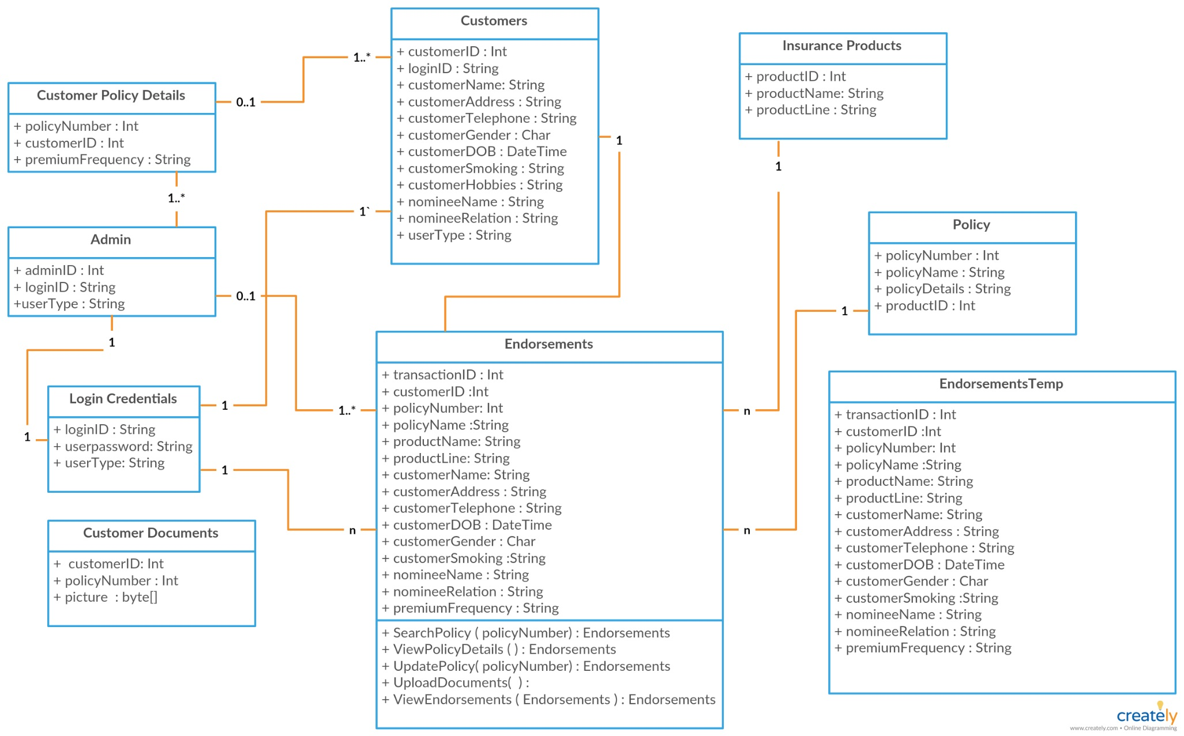
Class Diagram

Slide 7
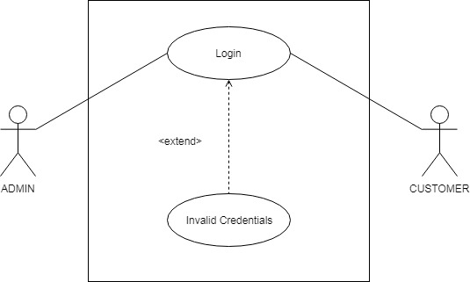
Use Case Diagram This is the use case diagram for login page where according to the login credentials and user type, the latter page is directed.

Slide 8
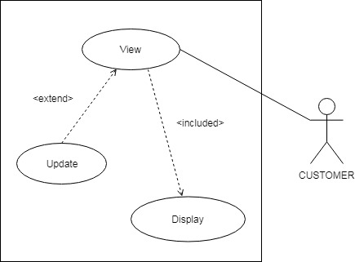
Use Case Diagram(contd…) If the login user type is customer, then his/her home page is directed which has choices like viewing the policy details or updating it.

Slide 9
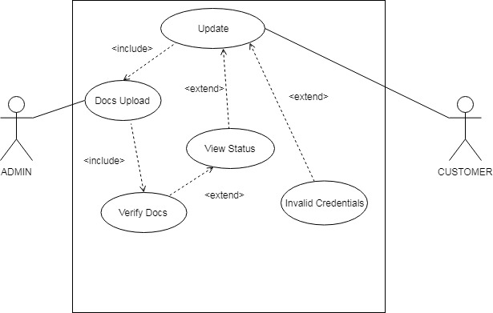
Use Case Diagram(contd…) If the Customer wants to update his/her details then he/she has to upload some valid documents regarding the updation and the Admin will decide whether the update request raised by the user is valid or not.

Slide 10
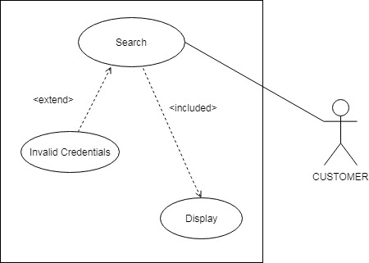
Use Case Diagram(contd…) Customer can search details of his/her policy by entering the Policy Number, Customer Name or Customer ID and Date of Birth.

Slide 11
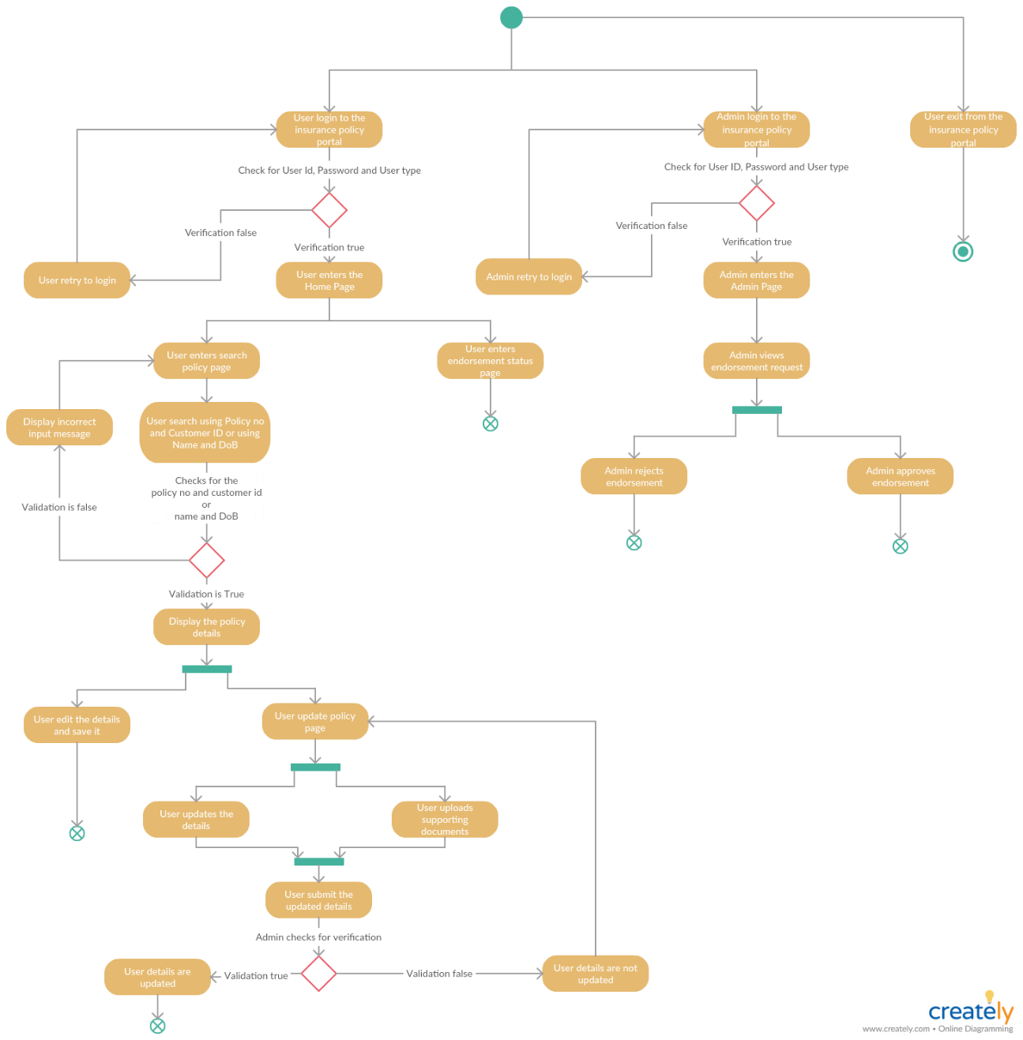
Sequence/Activity Diagram

Slide 12
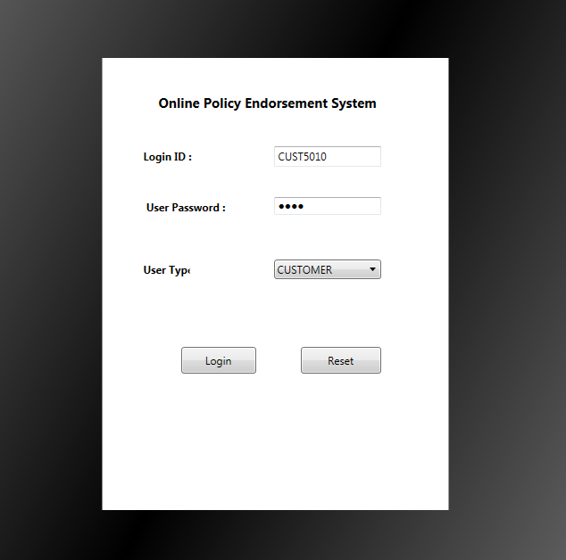
Screen shots (Customer Login)

Slide 13
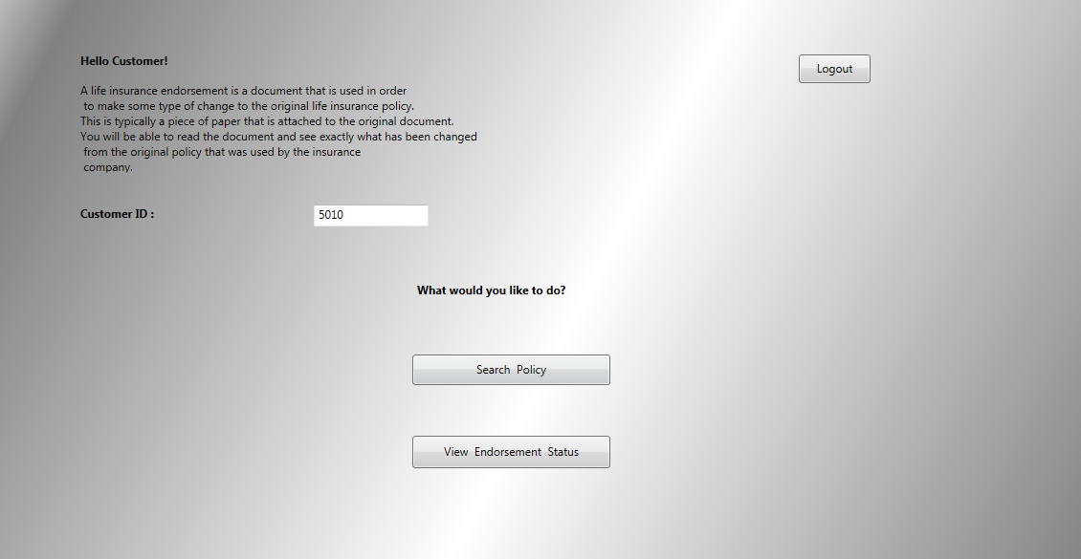
Screen shots (Customer Home Page)

Slide 14
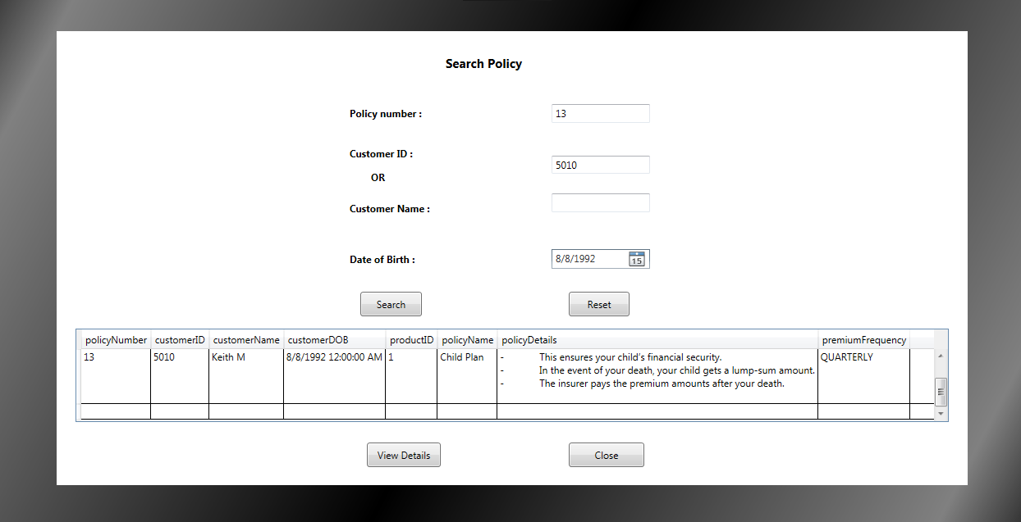
Screen shots (Search Policy Details)

Slide 15
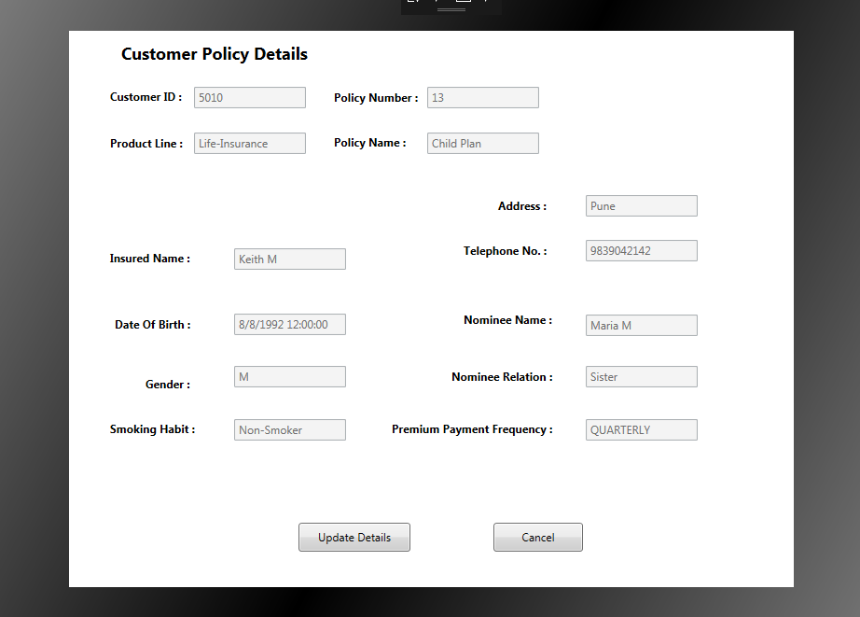
Screen shots (View Customer Details)

Slide 16
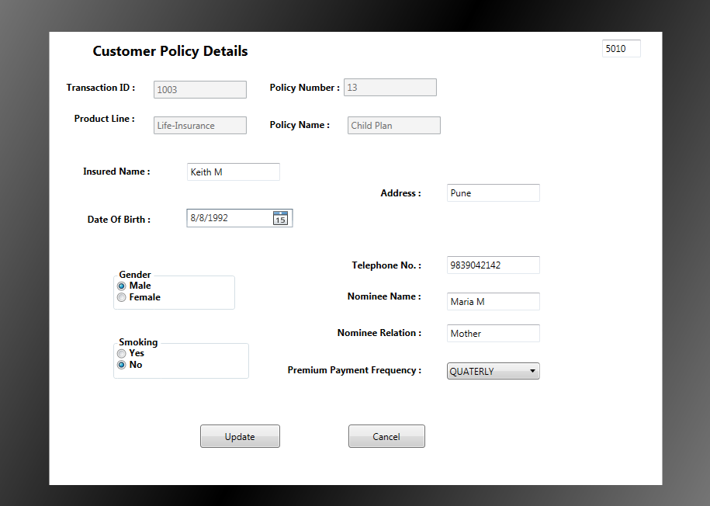
Screen shots (Update Customer Details)

Slide 17
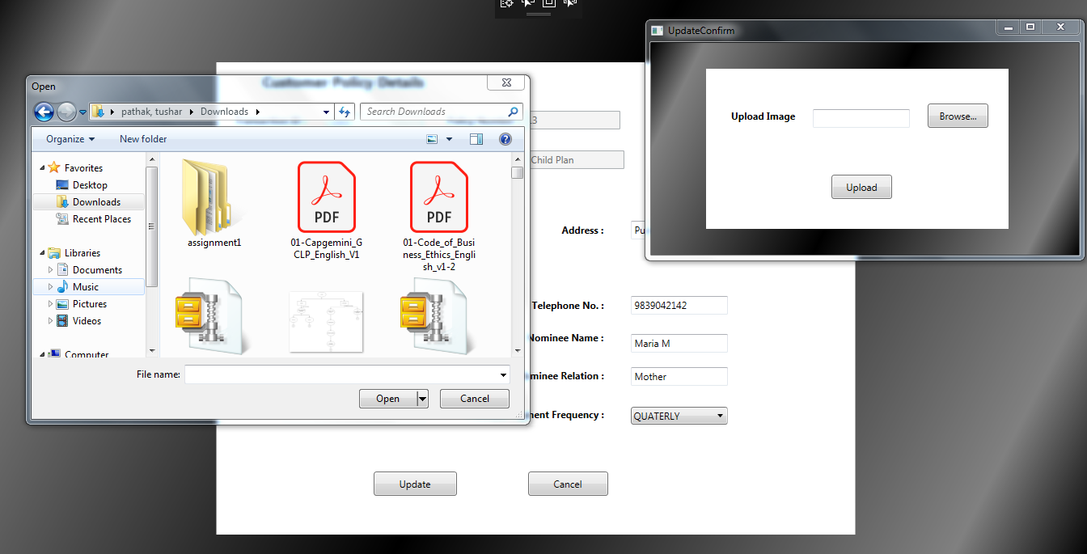
Screen shots (Document Upload)

Slide 18
Screen shots (Customer Home Page)

Slide 19
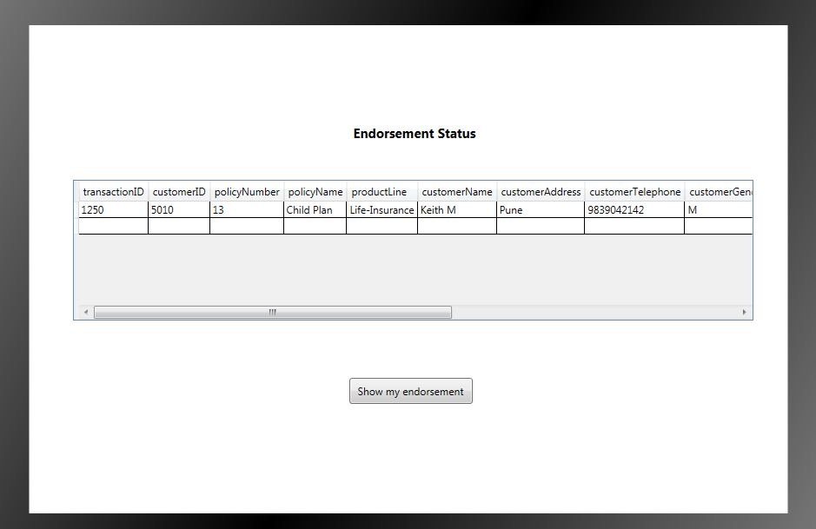
Screen shots (Endorsement Status)

Slide 20
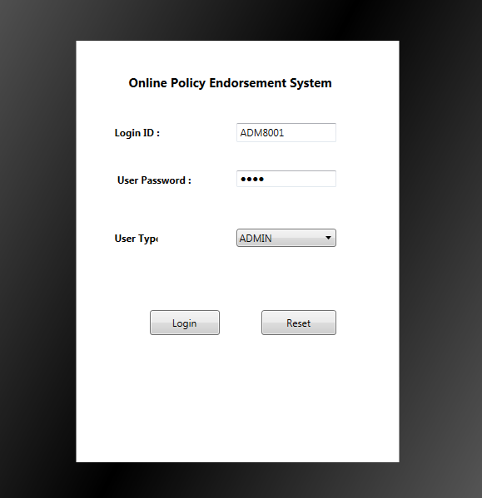
Screen shots (Admin Login)

Slide 21
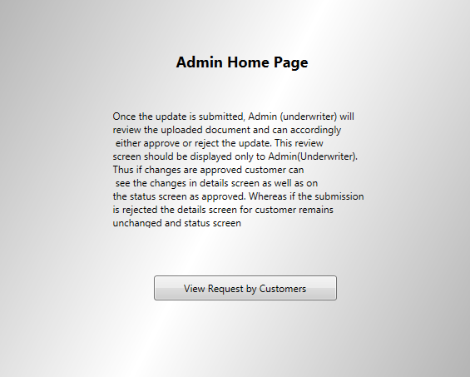
Screen shots (Admin Home Page)

Slide 22
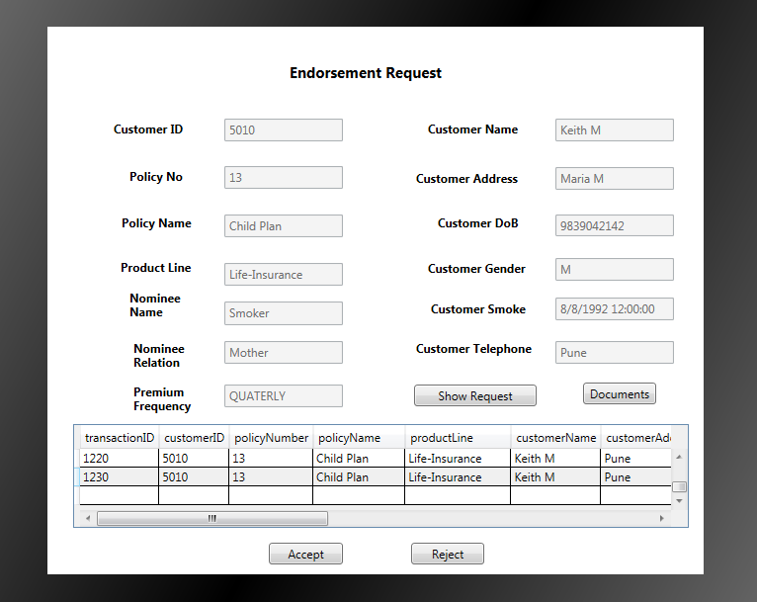
Screen shots (View Endorsement Request)

Slide 23
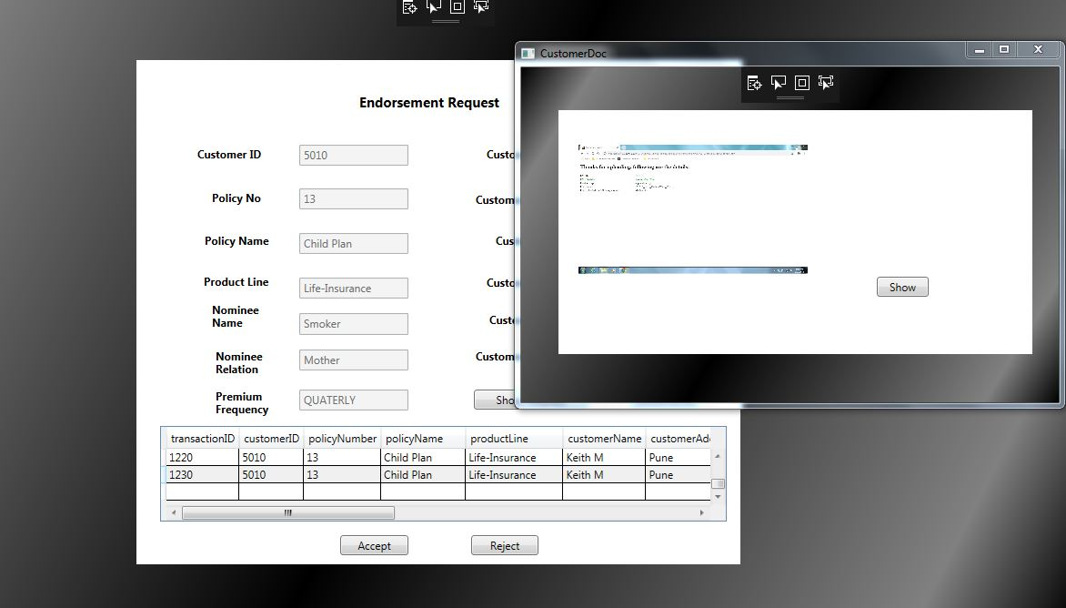
Screen shots (View Uploaded Document)

Slide 24
Future Enhancements
For Future purpose we can add some other functionalities in the application, such as:
Customer can register themselves for a new policy.
Customer can pay their premium from the application.
Customer can get notification about their premium frequency.

Slide 25
Thanks

